Slide 1
Climate Change Presentation
Myles Biss

Slide 2
Agenda
Raw Data
EDA Process
Data Cleaning
Interactive Dashboard
Drawing Conclusions
Thank You!
Citations

Slide 3
Raw Data Source
https://climateactiontracker.org/
Sourced Data from UN
Downloaded Raw Dataset
https://www.naturalearthdata.com/downloads/10m-cultural-vectors/
Admin 0 – Countries

Slide 4
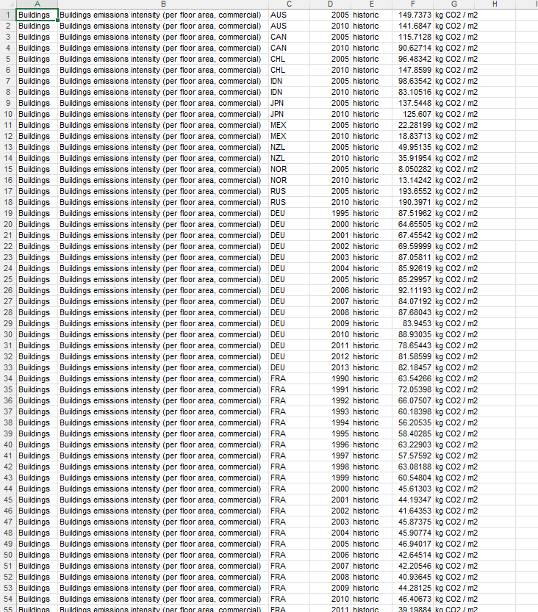
Raw Data

Slide 5
How Data Works
Emissions intensity of electricity generation | gCO2/KWH
World | 9636.82
2000 | 584.87
2001 | 586.34
2002 | 589.74
2003 | 602.79
2004 | 597.47
2005 | 602.05
2006 | 605.62
2007 | 614.45
2008 | 607.56
2009 | 603.76
2010 | 604.46
2011 | 611.9
2012 | 610.06
2013 | 611.69
2014 | 608.32
2015 | 595.74
Grand Total | 9636.82
Only Electricity data will be analyzed
All values from the dataset are ratios
World is just an average
Example is World Data only

Slide 6
EDA Process
Explanation in Jupyter Notebook

Slide 7
PowerBI

Slide 8
Sources

